Slide 1
Cyber-bullying classification and vulnerability detection
Sudipta Biswas 15.01.04.112
Rakib Hossain Ayon 15.01.04.120
Raphael Elvis Rozario 15.01.04.121
Fahim Md. Mahfuzur Rahman 15.01.04.047

Slide 2

Introduction to Cyber-bullying
The term ‘Cyber-bullying’ defines the usage of digital media and electronic communication to intimidate, threaten or bully individuals.

Slide 3

Types of Cyber-bullying
Harassment
Exclusion
Hate speech
Impersonation
Sexual remarks
Stalking

Slide 4
Effects of Cyber-bullying
Low self-esteem
Suicidal tendencies
Frustration
Cycle of hatred
Depression
Violation of free speech

Slide 5

Cyber-bullying Detection
Gather data on potential cyber-bullying content
Identify aggressive, bully words
Explore different algorithms
Detection based on high accuracy algorithm

Slide 6
Purpose
Prevention of violent and threatening comments
Reduction of hate speech
Promoting a healthy digital media environment
Improvement of mental health issues
Prevention of cyber victimization

Slide 7
Desired Features
Detection of cyber-bullying is quite critical and challenging, so these features are highly desired.
High detection rate
Reduction of false identification
Better performance
Reduced computation time
Direct resultant classes

Slide 8
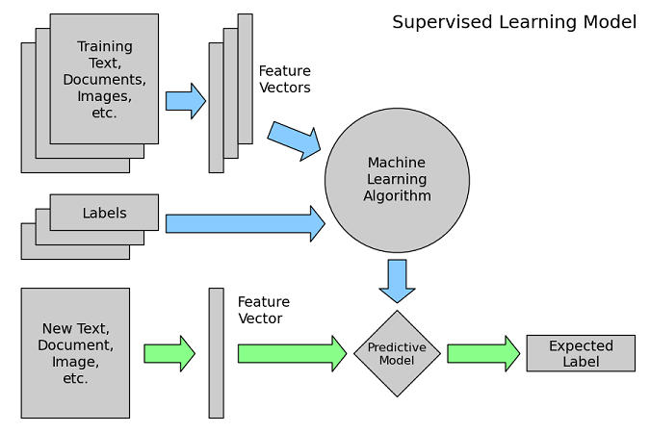
Model Training

Slide 9
Related Works
Paper No | Used Methodology | Result | Data Set | Limitations
Paper[1] | Text mining and lexicon based | Didn’t implement yet | Arabic tweet conversations | Lexicon on Arabic language doesn’t exist
Paper[2] | Support vector machine(SVM) | 79.412% accuracy | Account of Indonesian celebrities in Instragram | Only Indonesian language can be detected
Paper[3] | SVM with poly, linear, RBF, sigmoid kernel | 99.41% from SVM poly kernel | 12,729 data from www.Kaggle.com | Spelling mistakes cannot be detected

Slide 10
Related Works
Paper No | Used Methodology | Result | Dataset | Limitations
Paper[4] | SVM with poly, linear, RBF, sigmoid kernel | SVM linear gave highest accuracy | Comments of posts of Bangladeshi Facebook celebrities | spelling checker was not implemented
Paper[5] | SVM, NBM, K-NN, Decision tree | NBM gave highest accuracy | Instagram and Tweeter messages | Stemming and Spelling mistakes cannot be detected
Paper[6] | Machine Learning classifier with bigram, unigram | Bigram gave highest accuracy | Instagram posts of several account | no certain classifier the mentioned

Slide 11
Related Works
Paper No | Used Methodology | Result | Dataset | Limitations
Paper[7] | SVM,NB, K-NN, Decision Tree | Didn’t implement yet | Arabic texts from Twitter and Facebook | Only proposed algorithms without implementing

Slide 12
Solution Approach
Dataset collection
Platform and tool selection
Dataset cleaning and pre-processing
Classification
Result analysis

Slide 13
Dataset
Dataset collected from dataturks.com
Roughly 19000 comments
11162 labeled as Cyber-bullying comments
7839 labeled as non-bullying comments

Slide 14
Platform and Tools
Language – Python
IDE - Jupyter Notebook
Machine Learning library – Scikit-learn library
Classification methods – SVM and other popular classifiers.

Slide 15
Cleaning
The dataset was a bit messy so it needed to be cleaned at first. Our dataset cleaning phase included -
Punctuations and special characters removal
Digit or any numeric value removal
Stop words removal
Words with less than 3 characters removal
10 most frequent words removal

Slide 16
Pre-processing
We used the ‘nltk’ library for preprocessing the data.
Tokenizing
Tokenizing is the task of splitting up a sentence into pieces and throwing away punctuation characters.
Stemming
Words that indicate the same activity are replaced by a single word, the process is known as stemming.
Porter Stemmer
Lemmatizing
Lemmatization is similar to stemming but it brings context to the words. So, it goes a step further by linking words with similar meaning to one word.

Slide 17
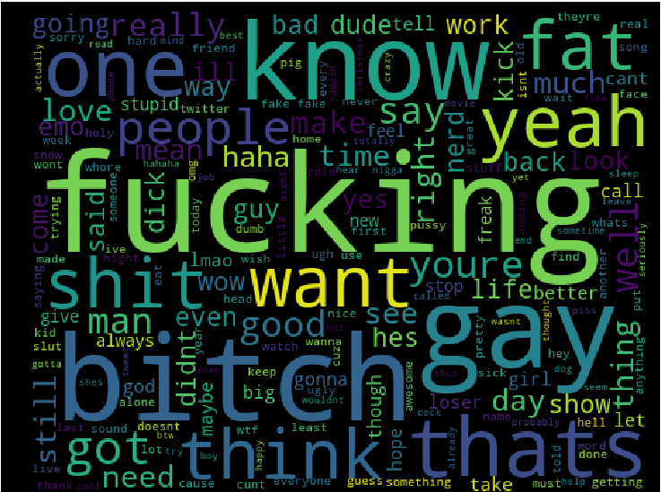
Most Used Bully Words

Slide 18
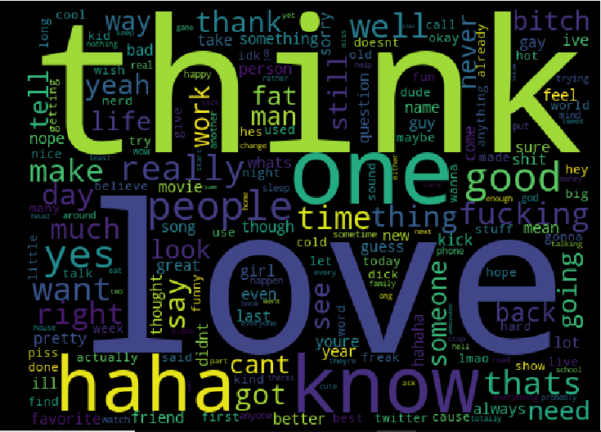
Most Used Non-bully Words

Slide 19
Feature Extraction
We vectorized the tokens with CountVectorizer(), Tf-idfVectorizer and HashVectorizer. CountVectorizer was the best suited among them.
It works with the following parameters:
Analyzer: word
Max-Df:
Ignore terms having a document frequency strictly higher than the given threshold.
It is set 1.0 by default.

Slide 20
Feature Extraction
Min-Df:
Ignore terms that have a document frequency strictly lower than the given threshold.
It is set 1.0 by default.
N-gram: is a contiguous sequence of n words. We used 1 and 2 grams.
From 15200 training data we have extracted nearly 56.5k features/tokens.
Token Pattern: Tokens as multiple letter or word.

Slide 21
Naïve Bayes
Used Multinomial Naïve Bayes
Though Naive Bayes is known as a decent classifier, it is known to be a bad estimator
Accuracy scored 85.6%

Slide 22
Logistic Regression
Using logistic regression we got an accuracy of 87.2%.
The central premise of Logistic Regression is the assumption that input space can be separated into two linear(straight)boundary.

Slide 23
K-NN
Used K-Nearest Neighbor algorithm. The principle behind nearest neighbor methods is to find a predefined number of training samples closest in distance to the new point, and predict the label from these points.
N_neighbor is set to 2
weight points by the inverse of their distance. in this case, closer neighbors of a query point will have a greater influence than neighbors which are further away.
Tree type algorithms cant be used for sparse matrix so used brute force algorithm.
Power parameter for the Minkowski metric uses minkowski distance.
Achieved accuracy is 89.05%

Slide 24
Decision Tree
The goal is to create a model that predicts the value of a target variable by learning simple decision rules inferred from the data features.
Criterion is set to entropy which gives information gain to measure quality of split.
Splitter used is best, minimum sample leaf is 1 and minimum split is set to 2
Achieved accuracy is 84.04%

Slide 25
Support Vector Machine
Kernel ‘linear’ and ‘radial basis function’ performed well.
Effective in high dimensional spaces. Uses kernel trick to handle nonlinear input spaces.
The core idea of SVM is to find a maximum marginal hyperplane that best divides the dataset into classes.
Support vectors are the data points, which are closest to the hyperplane. These points will define the separating line better by calculating margins. These points are more relevant to the construction of the classifier.

Slide 26
Support Vector Machine
Default parameters for linear.
Rbf and other nonlinear kernels performed poorly under default parameters.
So changed C=1, gamma = 10, decision function shape ’ovr’, one verses one.
C is the parameter for the soft margin cost function, this process involves trading error penalty for stability and a small gamma will give low bias and high variance while a large gamma will give you higher bias and low variance.
Linear scored 87.89% and RBF scored 93.76% accuracy.

Slide 27
Result Analysis
We worked on different classifier algorithms and achieved comparative results that are given below:
 | Naïve Bayes | Logistic Regression | K-NN | Decision Tree | SVM Linear | SVM RBF
Accuracy | 0.86 | 0.87 | 0.89 | 0.85 | 0.88 | 0.94
Precision | 0.86 | 0.87 | 0.89 | 0.86 | 0.88 | 0.94
Recall | 0.86 | 0.87 | 0.89 | 0.85 | 0.88 | 0.94
F-Score | 0.86 | 0.87 | 0.89 | 0.85 | 0.88 | 0.94

Slide 28
Result Analysis

Slide 29
Result Analysis

Slide 30
Result Analysis

Slide 31
Result Analysis
Ques: Why SVM scored better than other classifiers?
In our dataset which is not linearly separable, svm worked better for using its kernel trick to turn into a higher dimensional space meaning it converts non-separable problem to separable problems by adding more dimension.
It handles high dimensional datasets, computationally more efficient,. faster in training, better in accuracy with stability/robustness and memory efficient.
number of features is not greater than the number of samples, so no over-fitting or under fitting and for computation it doesn't directly provide probability estimates rather uses an expensive five-fold cross-validation.

Slide 32
Conclusion
Balanced dataset collection
Implemented required cleaning & preprocessing
Classified the text with satisfactory result

Slide 33
Future Work
Severity level of Cyberbullying
Constructive criticism classification
Different techniques to detect Cyberbullying
Mixed-language text classification

Slide 34
References
Alanood Hamad Alduailej, Dr.Muhammad Badruddin Khan. “The Challenge of Cyberbullying and its Automatic Detection in Arabic Text.” 2017 International Conference on Computers and Application (ICCA) by IEEE.
Miftah Andriansyah, Ali Akbar, Afina Ahwan, Ardiono Roma Nugraha, Nico Ariesto Gilani, Rizki Nofita Sari and Remi Senjaya. “Cyberbullying Comment Classification on Indonesian Selebgram Using Support Vector Machine Method”. 2017 Second International Conference on Informatics and Computing (ICIC) By IEEE.
Noviantho, Sani Muhamad Isa, Livia Ashianti.”Cyberbullying Classification using Text Mining”. 2017 1st International Conference on Informatics and Computational Sciences (ICICoS) by IEEE.

Slide 35
References
Shahnoor C. Eshan, Mohammad S. Hasan. “An application of Machine Learning to Detect Abusive Bengali Text”. 2017 20th International Conference of Computer and Information Technology (ICCIT) By IEEE.
Selma Ayúe Özel, Esra Saraç, Seyran Akdemir and Hülya Aksu.” Detection of Cyberbullying on Social Media Messages in Turkish”. 2017 International Conference on Computer Science and Engineering (UBMK) by IEEE.
Homa Hosseinmardi, Rahat Ibn Raﬁq, Richard Han, Qin Lv, Shivakant Mishra. “Prediction of Cyberbullying Incidents in a Media-based Social Network”. 2016 IEEE/ACM International Conference on Advances in Social Networks Analysis and Mining (ASONAM).
Batoul Haider, Maroun Chaoun, Fadi Yamout. “Cyberbullying Detection”. 2016 European Modelling Symposium.

